Slide 1
Conditional Execution: If Statements
By Rachael Sera
For Junior Knights

Slide 2
Conditional execution
So far, our programs do the same operations every time we run them
Conditional execution allows us to perform different actions based on conditions

Slide 3
If statement
We use the “if-statement” to execute code if a condition is true (and not execute the code if it’s not true)

Slide 4
Indentation
Indentation is used to group lines of code together
Inappropriately aligning lines will produce errors
So far, our programs have all been left-justified

Slide 5
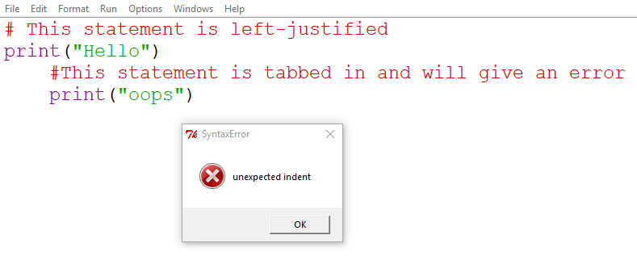
Indentaiton

Slide 6
Boolean Expressions
Statements that evaluate to either true of false
<operand> <operator> <operand>
Operator in if-statements: a relational operator
2 + 3
2 and 3 are the operands and + is the operator
Notes:
When we have 2+3, 2 and 3 are the operands and + is the operator. That expression evaluates to 5. Boolean expressions will evaluate to true or false.

Slide 7
Relational Operators
== equal to
!= not equal to
> greater than
>= greater than or equal to
< less than
<= less than or equal to

Slide 8
Boolean Expression Examples
Are these expressions true or false?
5 == 5
5 == 4
5 > 4
5 < 4
5 != 5
5 != 4
5 >=4
5 <= 4
5 <= 5
4 > 5
4 < 5
4 <= 5

Slide 9
If-Statement
The if-statement will execute code if a condition is true (and not execute the code if it’s not true)
Indentation is used to group lines of code together
Code that is indented under the if-statement is part of the if-statement and is what will or won’t be executed based on whether the condition is true or not

Slide 10
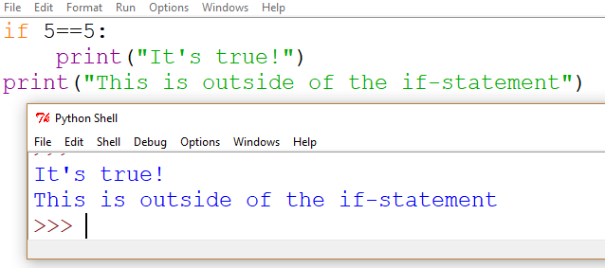
If-statement Example
Everything indented under the if-statement will execute only if the condition is true (in this example it is)
Anything left-justified is outside of the if-statement and will execute regardless, like our programs before
You can have multiple lines inside the if-statement

Slide 11
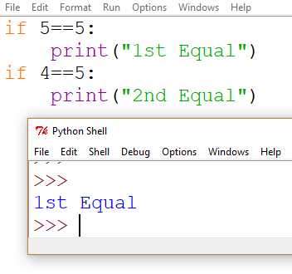
If-statement Example
The first statement is true, so “1st Equal” prints
But the second statement is not true, so “2nd Equal” does not print

Slide 12
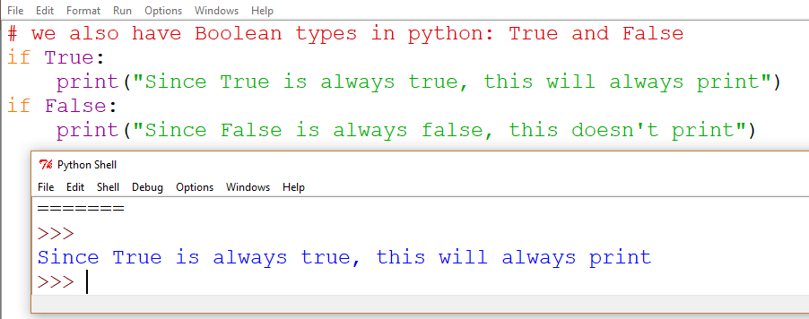
Boolean data type
This is to illustrate that if-statements work by evaluating a condition and to introduce the Boolean type

Slide 13
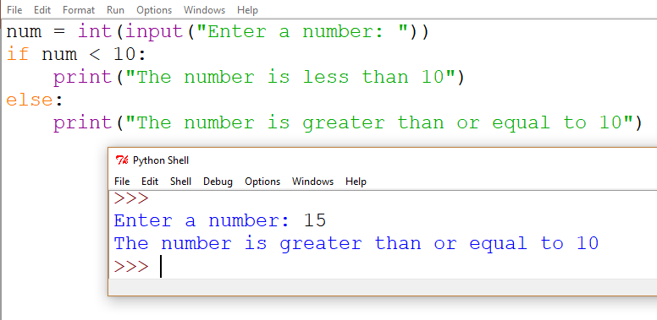
Else
Use else to make something “else” happen when the statement is false

Slide 14
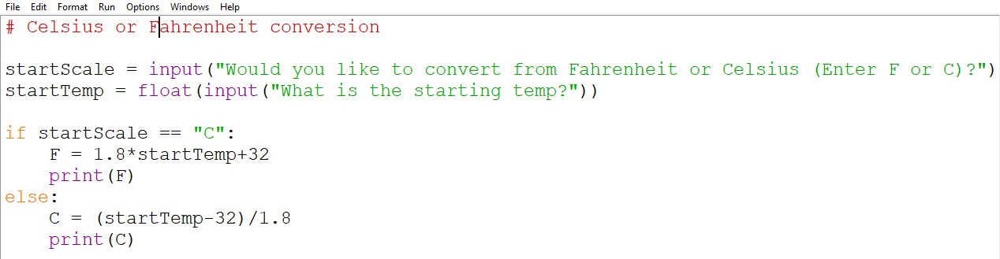
Temperature Conversion IF/Else Example
Notes:
Note, string inputs ARE case sensitive (so “C” is not equal to “c”)

Slide 15
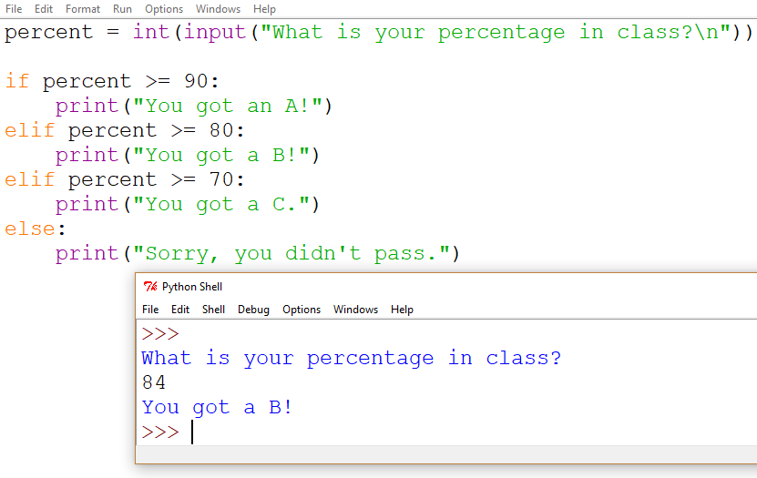
Elif
“Elif” is like “else” but instead of simply catching the opposite of the “if” condition, it can check for other, specific conditions
The first condition that is true will execute, and the rest will be skipped
The way this is structured, order matters. If percent >= 90, then we print, and we don’t check to see if it’s also >= 80.
If we move one of the other cases up, it will give misleading output.
Remove the “el” and then multiple statements can print

Slide 16
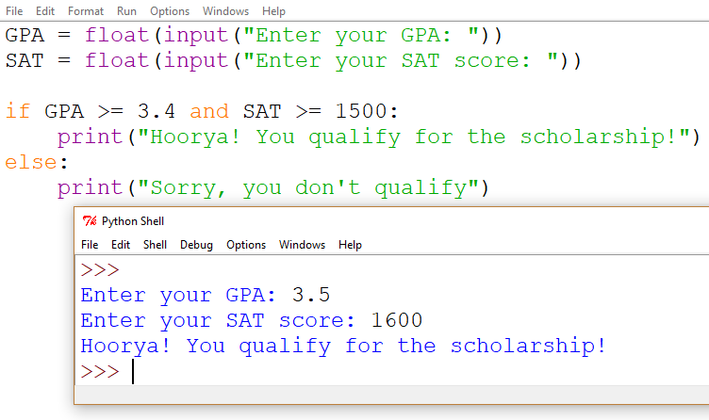
AND
Use “and” when multiple conditions are required

Slide 17
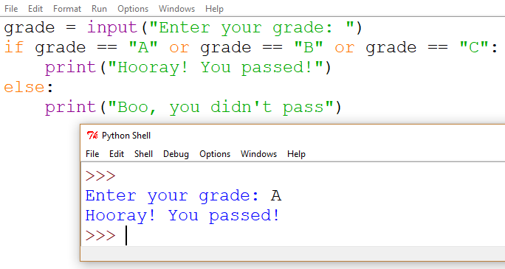
OR
Use “or” when only one (at least) of multiple conditions should cause the code to execute

Slide 18
Materials
http://www.eecs.ucf.edu/JuniorKnights/material/
Book for additional reading
These slides are
github.com/rsera/junior-knights
Meeting dates
The problems for today are: goo.gl/aUipex
Python Lesson 4 If Statement.pptx

